Slide 1



Redefining Retail
Team 5 (9:50am Class)
Accidental Analysts

Slide 2

- Case Scenario -
Can Walmart Continue to thrive on cost leadership?
2012
Amazon Acquired Kiva Systems
2013
Amazon invests in Drone Tech
2013
Walmart : $3bn Loss estimated due to stock operations issues
2014
Walmart facing threat of staff-strikes

Slide 3





- Team Members-
Accidental Analysts

Slide 4




- Walmart - 2013-
19.3%
$85
$467bn
General expense increase in last 3 years
Stock price : Least growth in last 3 years
Least growth in last 3 years

Slide 5
- Objective-
Mission
Prevent Walmart from losing Cost leadership in Retail segment
Problem Statement
Analyze Walmart data from 45 stores and give recommendation on pricing and growth strategy

Slide 6






Process Flow
- Team Members-
Data Gathering
Understanding Business Problem
Data Cleaning
Extracting Insights
Recommendations
Data Analysis as per Business Problems
Analysis and Recommendations

Slide 7
DATASET INTRO
Sales Data
Store Opening data
Store ID
Date – Week
Temperature – Avg temp in area
Fuel Price – cost of fuel in area
Markdown 1-5 – Anonymized data related to promotional markdowns
CPI – Consumer Price Index
Unemployment Rate
ISholiday – Whether a week is a holiday week
Store ID
Opening Date
Address
ZipCode
State
City
Rows : 6436
Columns: 9
Features
Markdown 1
Markdown 2
Markdown 3
Markdown 4
Markdown 5
Store
Date
Store Data
Store ID
Store Type
Size

Slide 8
Data Cleaning
Merge Tables
All three data tables were Merged into single data frame
Subset data frames created for analysis
Handle Missing Data
All columns – if rows are null – replace with 0
Check for critical rows – IF there is consistent data
Removing Duplicate columns
Remove unwanted Info
Drop columns from which there is no consistent data
Drop columns where there was there was inaccurate mapping (Structural errors) – Different values for same column

Slide 9
User Stories Tackled
- Team Members-
Q1. Store classification Overview
Q2. Impact of Holidays on Sales?
Q3. Impact of Markdown on Sales?
Q4. Impact of other external factors like temp, fuel price unemployment rate & CPI on sales?

Slide 10
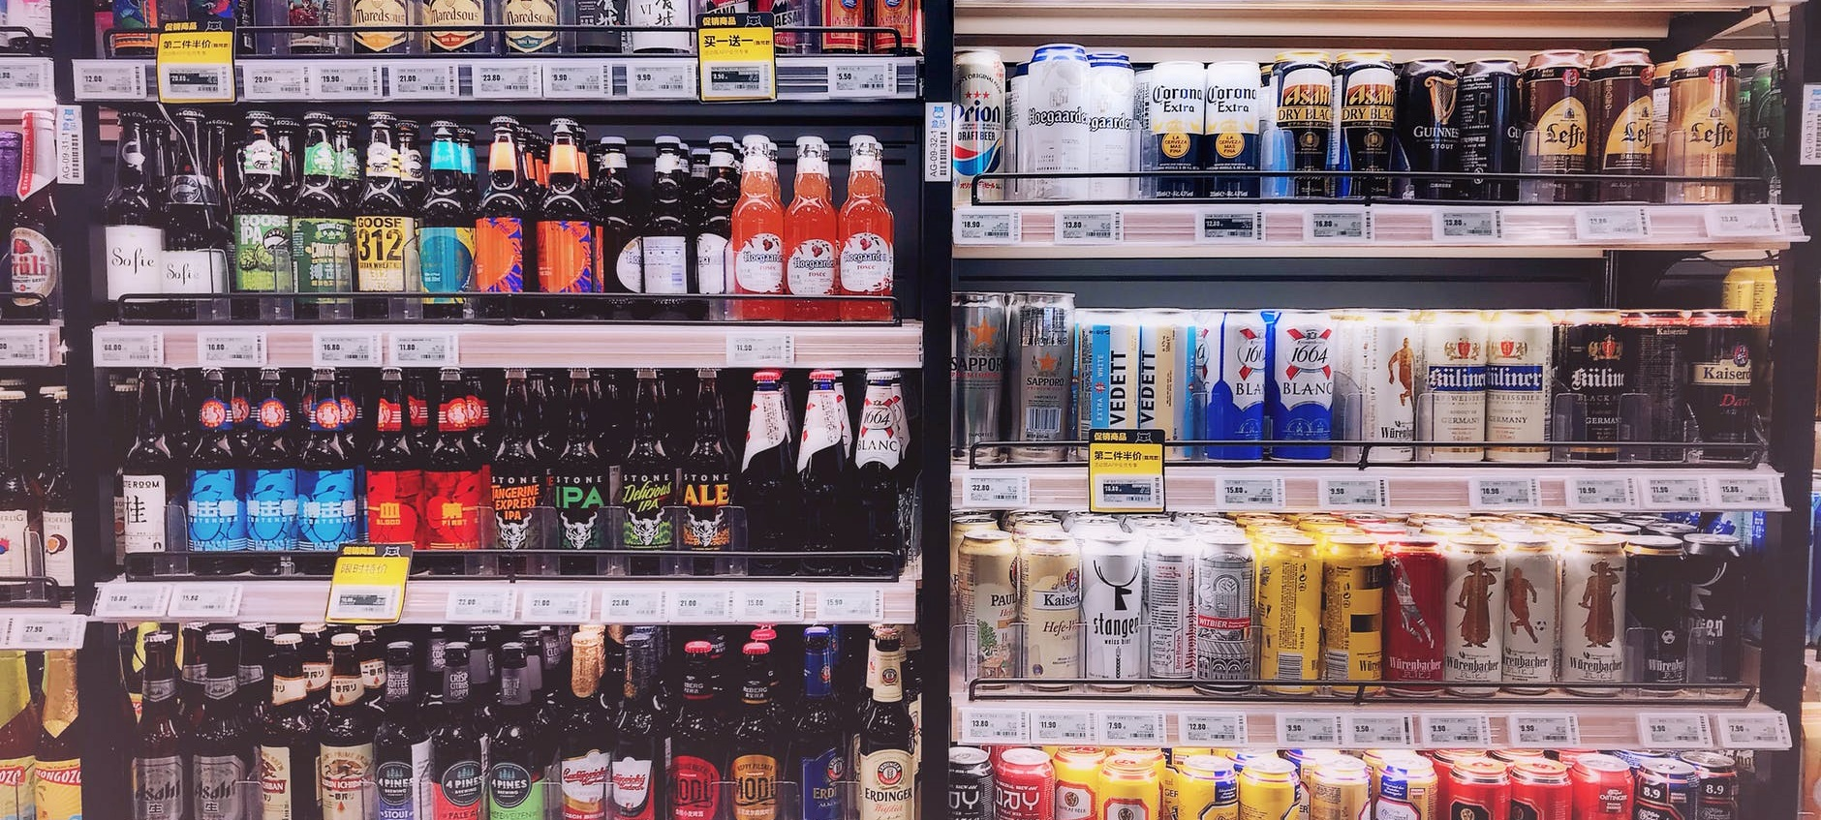
`
Background - Store types
TYPE A
TYPE B
TYPE C
Walmart Supercenter
Discount Stores
Neighborhood Markets
Average size - 187,000 square feet
Average size - 107,000 square feet
Average size - 42,000 square feet
Walmart Supercenter
Discount Stores
Neighborhood Markets
Offer 142,000 different items.
Employ 350 or more associates on average
Offer around 120,000 items
Employ an average of 225 associates
employ 95 associates on average and offer about 29,000 items
Offerings
Combining full grocery lines and general merchandise ,specialty shops such as vision centers, hair salons
Offerings
Value-priced general merchandise.
Offerings
Groceries, pharmaceuticals and general merchandise
Notes:
4606 orders of 138M delivered

Slide 11
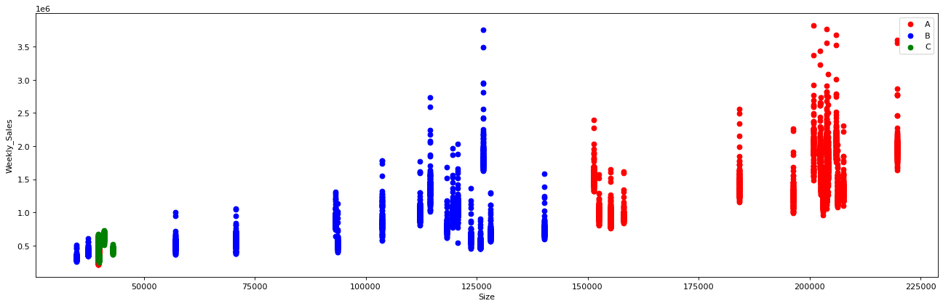
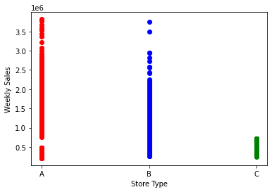
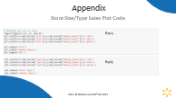
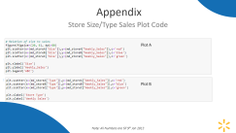
Store Size/Type Sales Overview
Plot A
Plot B
Type A stores will have higher sales and higher transactions – due to size
Type B stores will have moderate sales and moderate transactions
Type C stores will have Lower sales volume and Lower transactions
Note: All Numbers are till 9th Jan 2013

Slide 12

Sales Analysis
4 X
Effect of Markdowns
Sales Trends
Effect of Holidays
Quarterly Performance
State wise Performance
Store type trends
Holiday type trends
State wise trends
Notes:
Icon change

Slide 13
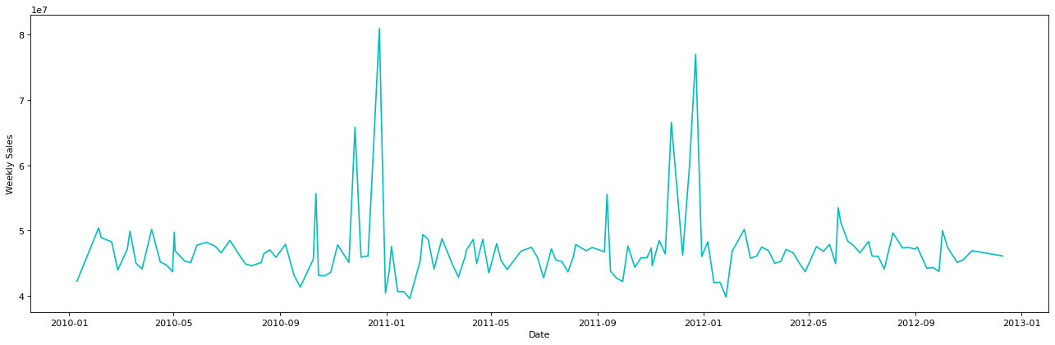
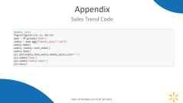
Sales Overview
Observations
Months Nov - Jan
There is a Sudden peak in Weekly sales
Both Peaks are after a dip in sales
T
T
November to January has two holiday seasons – Thanksgiving and Christmas – This could be possible reason for the spike
Sudden Dip before and after the week – Could indicate savings behavior & people usually are spending time with their families
Note: All Numbers are till 9th Jan 2013
Notes:
Temprary emplyee

Slide 14
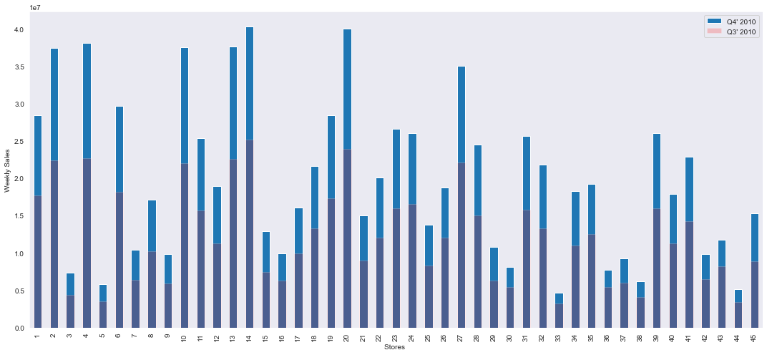
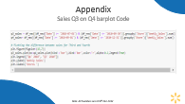
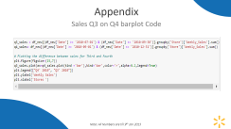
Sales Q3 on Q4
Observations
Q3-Q4 sales are observed to be higher than the first half of the year.
Q3 > Q4
Second half of the year is clubbed with festive seasons and hence has more sales but Q3>Q4 is counterintuitive finding, and we will need more data to understand this.
Walmart should create Gift bundles in second half of the year and create more occasions to buy in first half.
An occasion like ‘Last day of Feb’ or ‘Spring-Fest Sales’ on the lines of Black Friday will create the required engagement.
Note: All Numbers are till 9th Jan 2013
Notes:
Walmart should Ramp up should create Gift bundles in second half of the year and create more occasions to buy in first half.
Something similar to black friday

Slide 15
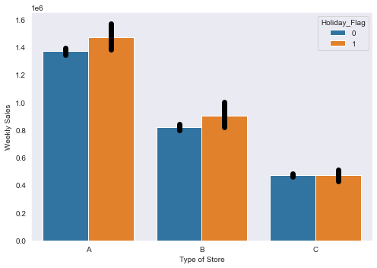
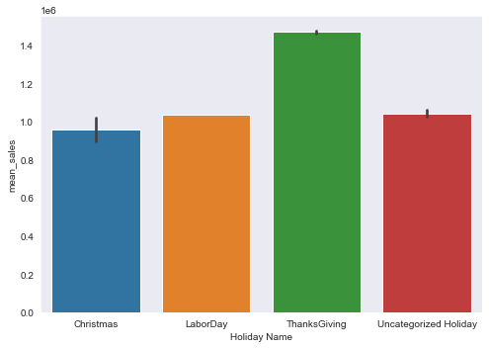
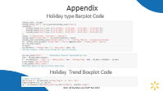
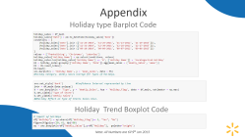
Holidays
Observations
Mean weekly sales is higher during thanksgiving weeks. But type C stores have no impact of Holidays
Since Holidays ask for more diverse purchases and require planned visits, neighborhood stores do not see any change in the purchase behaviors.
Higher sales during Thanksgiving can be attributed to – shorter shopping window and Black Friday sales that follows – leading to higher sales volume
Note: All Numbers are till 9th Jan 2013

Slide 16
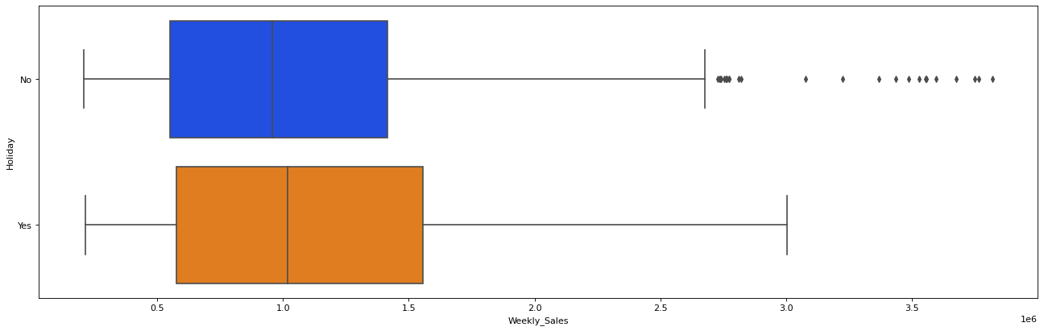
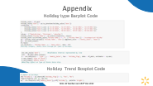

Holidays
Observations
-Around $100K difference in the median(50%) weekly sales during holiday weeks compared normal weeks
- Range of sales is larger in holiday weeks
- No Holiday weeks have more outliers
No Holiday weeks – erratic outliers could be due to customers who have lesser frequency and hence bigger market basket size, we need to tap this market.
$100 K difference in median can be attributed to added purchase of gifts - increasing the sales volume.
Note: All Numbers are till 9th Jan 2013
Notes:
During no holiday week, promote bulk buying by providing free delivery service on orders above certain limit.
During holiday season, promote bulk buying by providing store points.

Slide 17
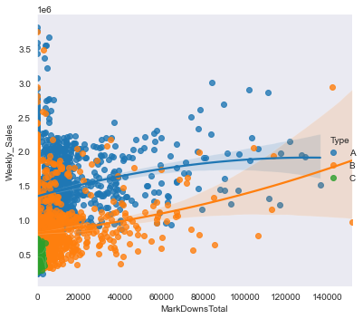
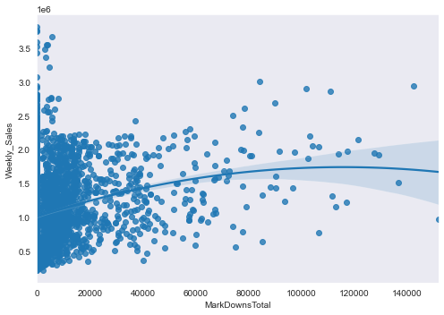
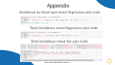
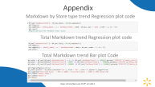
Markdown
Observations
Markdown's trend show a positive impact for Type B stores.
Type A store remains relatively flat.
Markdown effect on total weekly sales only sees a moderate impact
Markdowns are the total amount reduced on the price for a set of slow-moving products –so as to enable their sales
Trend show a positive impact of Markdown on Type B stores. This can be because Type A stores are mainly dependent on bulk planned purchase and type C on quick convenience purchase. Both behaviors are difficult to change
Markdowns show a diminishing returns plot. Hence Mark down should be targeted only on type B stores in Moderate Magnitude to get the best return on investment
Note: All Numbers are till 9th Jan 2013

Slide 18
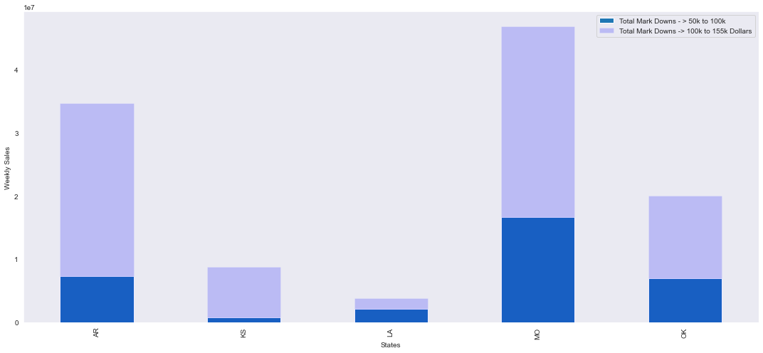
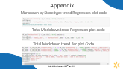

Markdown
Observations
There is more than 100% increase in weekly sales when markdown value is in range of 100k to 155k
Stores in different states behave differently on markdown- Hence Walmart should have a separate markdown strategy for each store
Note: All Numbers are till 9th Jan 2013

Slide 19

Pricing- Recommendations
01
Better Planned Markdowns For Type B stores
02
Prepare for advance purchasing cycle during Holiday season
03
Offer Gift Bundles in Second Half of the year.
Create Sales Occasions in first half of the year
04
During no holiday week, promote bulk buying by providing free delivery service on orders above certain limit.
During holiday season, promote bulk buying by providing store points.
Notes:
Just like Costco.

Slide 20

External Factors Analysis
Effect of Markdowns
Sales Trends
Effect of Holidays
Quarterly Performance
State wise Performance
Store type trends
Holiday type trends
State wise trends
Notes:
Icon change

Slide 21
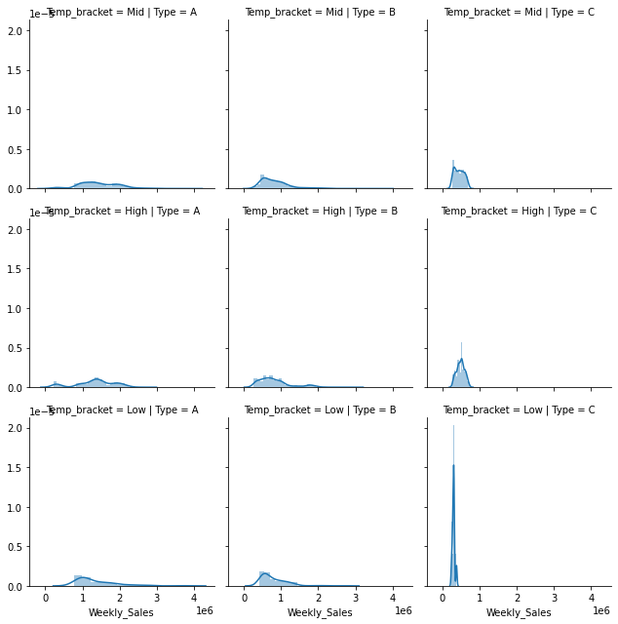
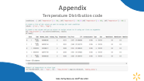

Temperature
Temperature
Observations
Type C stores peak when temperature is low
Type A and B don’t have much difference
Type C peak can be explained by the convenience factor for consumers during winters.
Note: All Numbers are till 9th Jan 2013

Slide 22
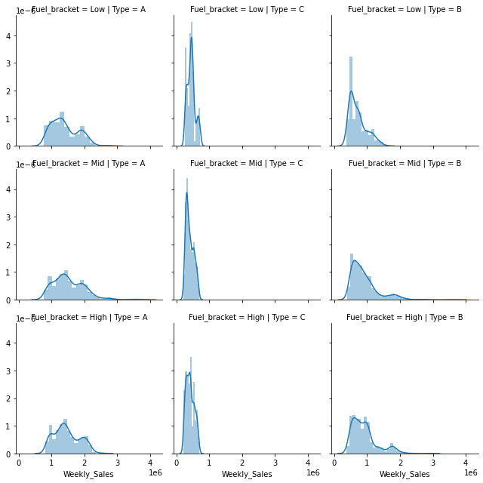
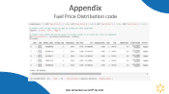
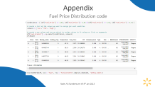
Fuel Price
Fuel Price
Observations
Type C stores peak when fuel price is low
Type A and B don’t have much difference
More number of sales in Type C when fuel price is low can indicate that the type C stores might be spread apart –in distance, hence uneconomical to travel if fuel price is high
Note: All Numbers are till 9th Jan 2013

Slide 23
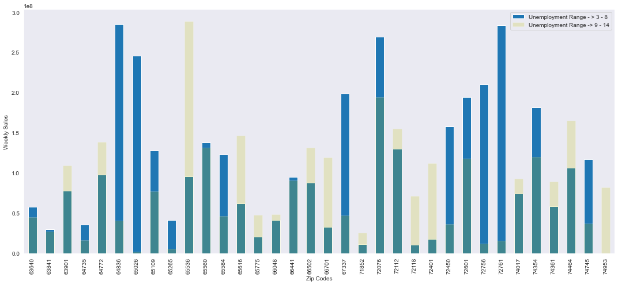
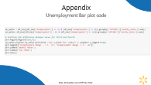
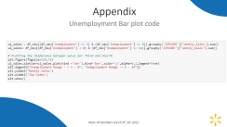
Unemployment
Unemployment
Observations
There are few zip codes such as 63901 where the Unemployment range has no effect on the Weekly Sales.
This graph shows how unemployment ranges are affecting various Zip codes.
Note: All Numbers are till 9th Jan 2013

Slide 24
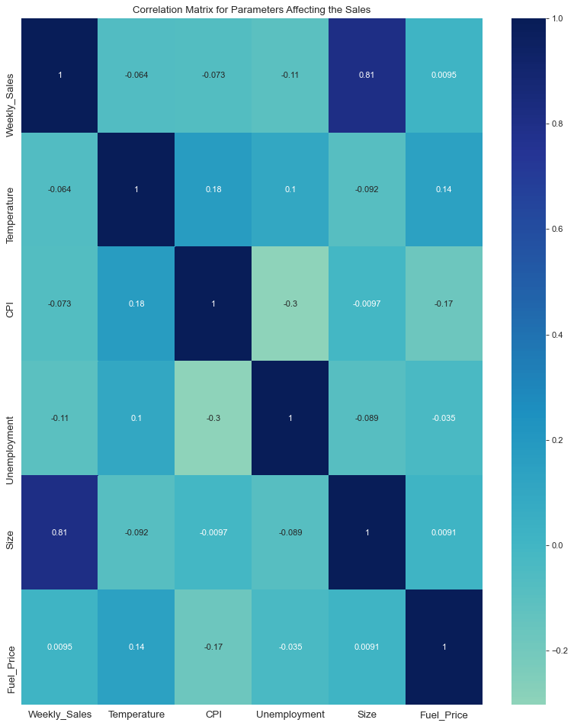
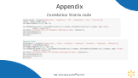
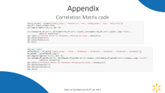
Correlation Matrix – Other Factors
Observations
As per the correlation Matrix, we can say that size of store is significantly & positively correlated with Weekly sales.
On the other hand, Unemployment shares significant but negative correlation.
Note: All Numbers are till 9th Jan 2013
Milestone | Incremental | Outlets | Fees per Outlet $ | Milestone payment $
1 | 20,000 | 20,000 | 5 | 100,000
2 | 40,000 | 20,000 | 5 | 100,000
3 | 60,000 | 20,000 | 6 | 120,000
4 | 80,000 | 20,000 | 6 | 120,000
5 | 100,000 | 20,000 | 6 | 120,000
6 | 125,000 | 25,000 | 7 | 175,000
7 | 150,000 | 25,000 | 7 | 175,000
8 | 175,000 | 25,000 | 7 | 175,000
9 | 200,000 | 25,000 | 7 | 175,000
10 | 250,000 | 50,000 | 7 | 350,000
11 | 300,000 | 50,000 | 7 | 350,000

Slide 25
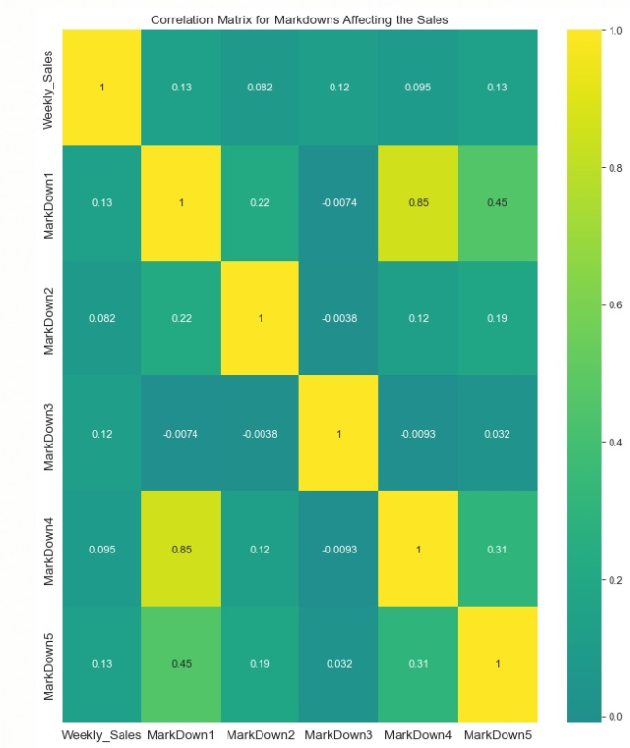


Correlation Matrix – Markdown
Observations
Observations
As per the correlation Matrix, we can say that Markdown 1 , 3 and 4 are is significantly & positively correlated with Weekly Sales
Note: All Numbers are till 9th Jan 2013

Slide 26
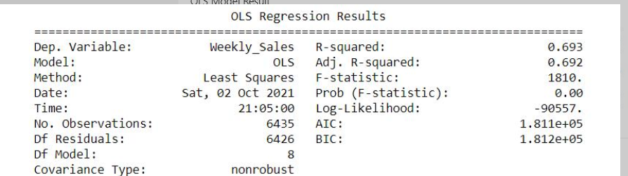
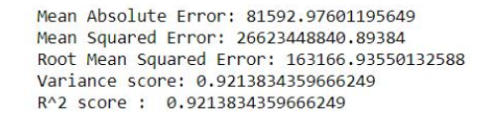
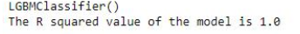
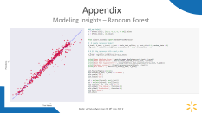

Modeling
Holidays
OLS Regression Model
Random Forest Regression Model Results
LGBM Regression Model
The purpose of running three models is to justify which regression works best for our parameters.
The key factor we are looking in these regression models is the R-square values and how it has increased as we have used different models.
Our Analysis has been based on the Test and the Predicted Data for Weekly Sales based on various factors
We have run three models using the libraries scikit learn, lightgbm and statsmodels.api
Ordinary Least Squares Regression
Random Forest
Light Gradient Boosted machine
​
Note: All Numbers are till 9th Jan 2013

Slide 27



Strategy - Recommendations
Truck Stores
01
Open smaller truck store for these neighborhoods during winter season.
Fuel Price Strat
State wise Strategy
02
In Areas and States with higher fuel price, Walmart should open more smaller neighborhood stores
03
Move towards ecommerce
E Commerce
04
Separate Marketing Strategies for states with different CPI & Unemployment

Slide 28
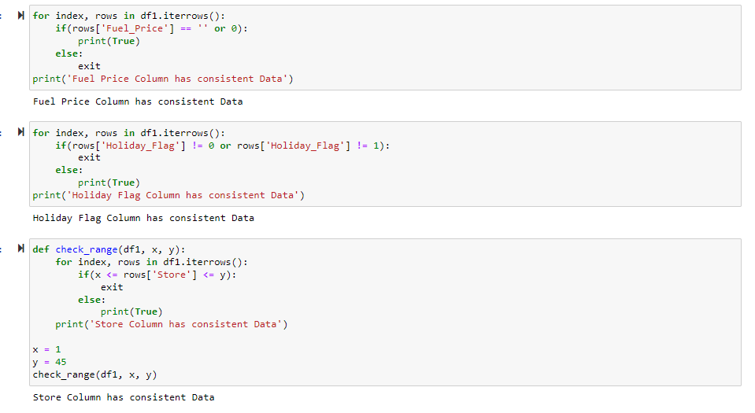
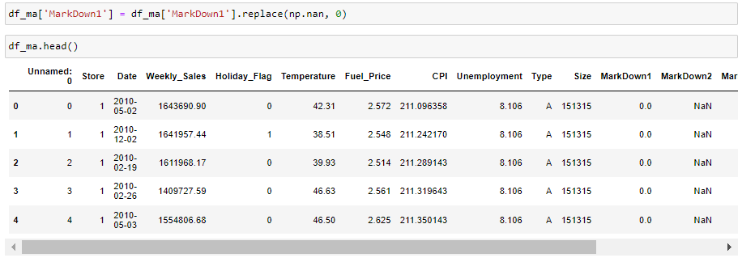
Appendix
Data Consistency check
Null values check
Note: All Numbers are till 9th Dec 2013

Slide 29
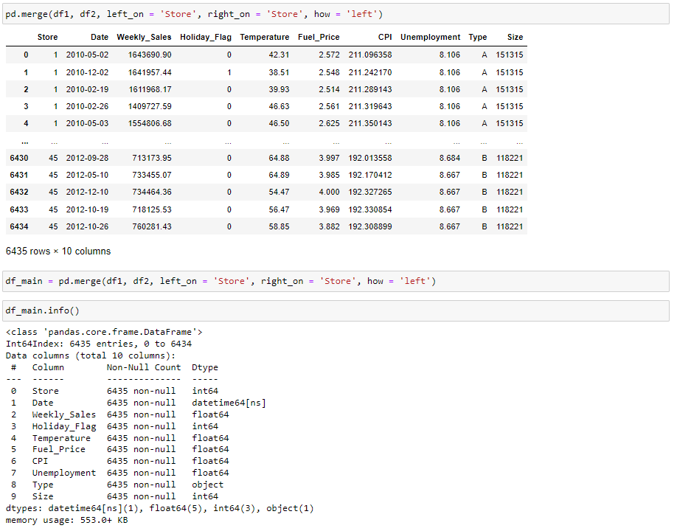
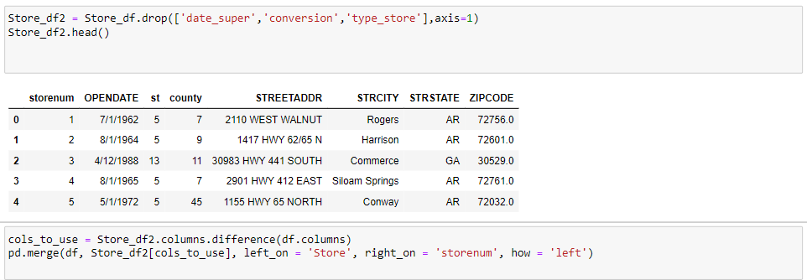
Appendix
Data frames Merging
Note: All Numbers are till 9th Jan 2013

Slide 30
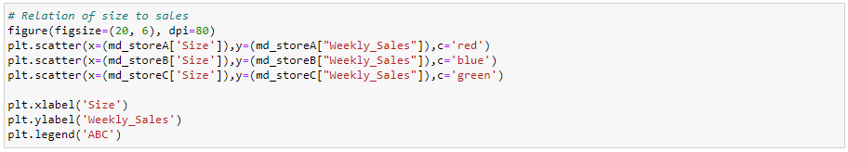
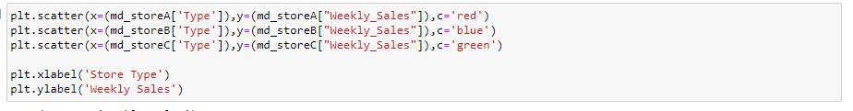
Appendix
Store Size/Type Sales Plot Code
Plot A
Plot B
Note: All Numbers are till 9th Jan 2013

Slide 31
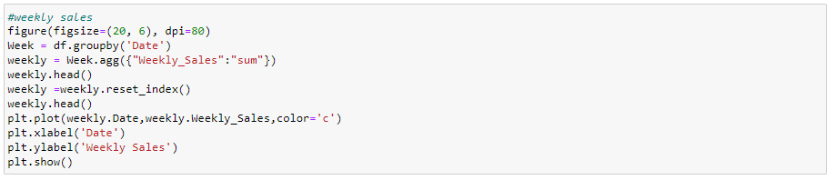
Appendix
Sales Trend Code
Note: All Numbers are till 9th Jan 2013

Slide 32
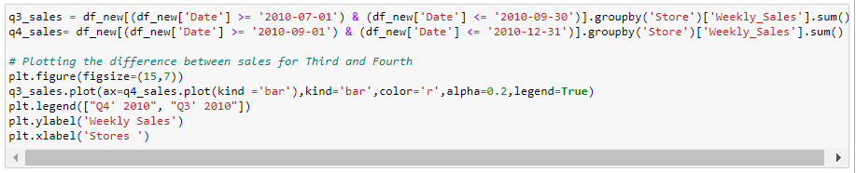
Appendix
Sales Q3 on Q4 barplot Code
Note: All Numbers are till 9th Jan 2013

Slide 33
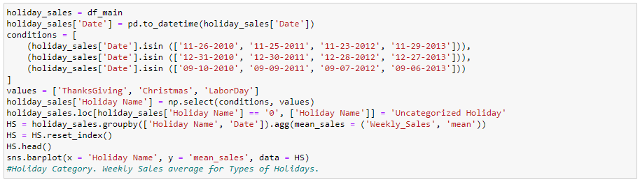
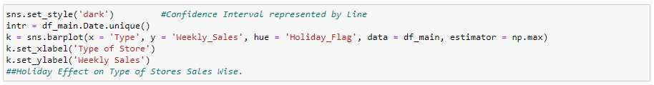
Appendix
Holiday type Barplot Code
Holiday Trend Boxplot Code
Note: All Numbers are till 9th Jan 2013

Slide 34
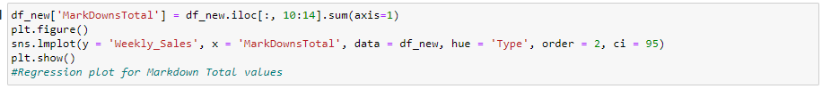
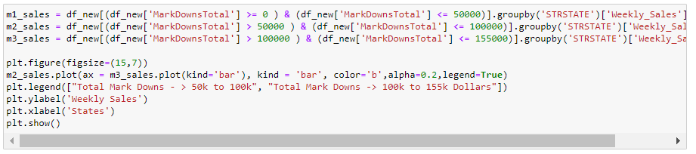
Appendix
Markdown by Store type trend Regression plot code
Total Markdown trend Regression plot code
Total Markdown trend Bar plot Code
Note: All Numbers are till 9th Jan 2013

Slide 35

Appendix
Temperature Distribution code
Note: All Numbers are till 9th Jan 2013

Slide 36

Appendix
Fuel Price Distribution code
Note: All Numbers are till 9th Jan 2013

Slide 37

Appendix
Unemployment Bar plot code
Note: All Numbers are till 9th Jan 2013

Slide 38


Appendix
Correlation Matrix code
Note: All Numbers are till 9th Jan 2013

Slide 39


Appendix
Modeling Insights – Random Forest
Note: All Numbers are till 9th Jan 2013

Slide 40


Appendix
Modeling Insights - OLS
Note: All Numbers are till 9th Jan 2013

Slide 41

Appendix
Modeling Insights – Light GBM
Note: All Numbers are till 9th Jan 2013

